Slide 1
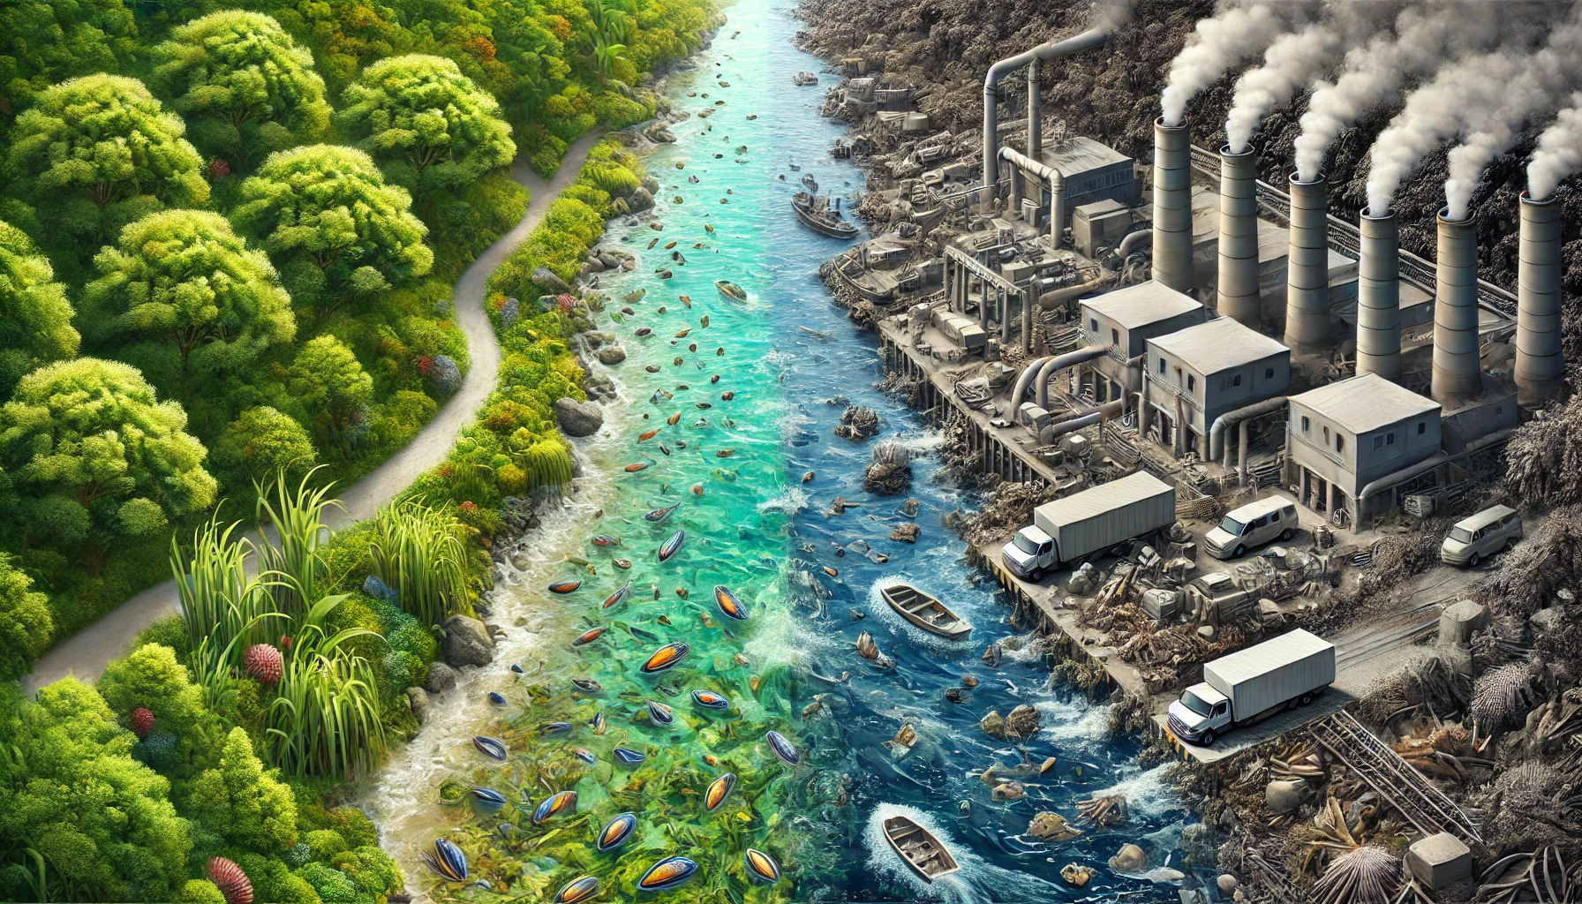
Evolutionary Rescue in Polluted Environments: Modeling Population Survival
A Theoretical Model on Population Dynamics, Immigration, and Competition
Eugenio Melo & Qingdong Zhu
Notes:
Good morning. Today, we’re excited to share our project with you. This work was developed collaboratively by the two of us, with valuable support from our professors and colleagues during our meetings. Together, we created a basic model of evolutionary rescue in discrete time, incorporating factors like immigration and competition.

Slide 2

From Recipe to Results: Understanding Our Approach
Objective of this presentation:
To demonstrate the full value of our project beyond the results
Breaking down our process and components to show how the model works.
Eugenio Melo & Qingdong Zhu
Notes:
Simply showing the results might not be enough to convey the full importance of our project. Our goal in this presentation is to demonstrate the broader value behind our work. Although we did our programming in R using RStudio, this is a ‘Theoretical Ecology and Evolution Research’ course—not a programming class—so let’s focus on the biology.

Slide 3

From Recipe to Results: Understanding Our Approach
Objective of this presentation:
To demonstrate the full value of our project beyond the results
Breaking down our process and components to show how the model works.
Eugenio Melo & Qingdong Zhu
Notes:
…

Slide 4
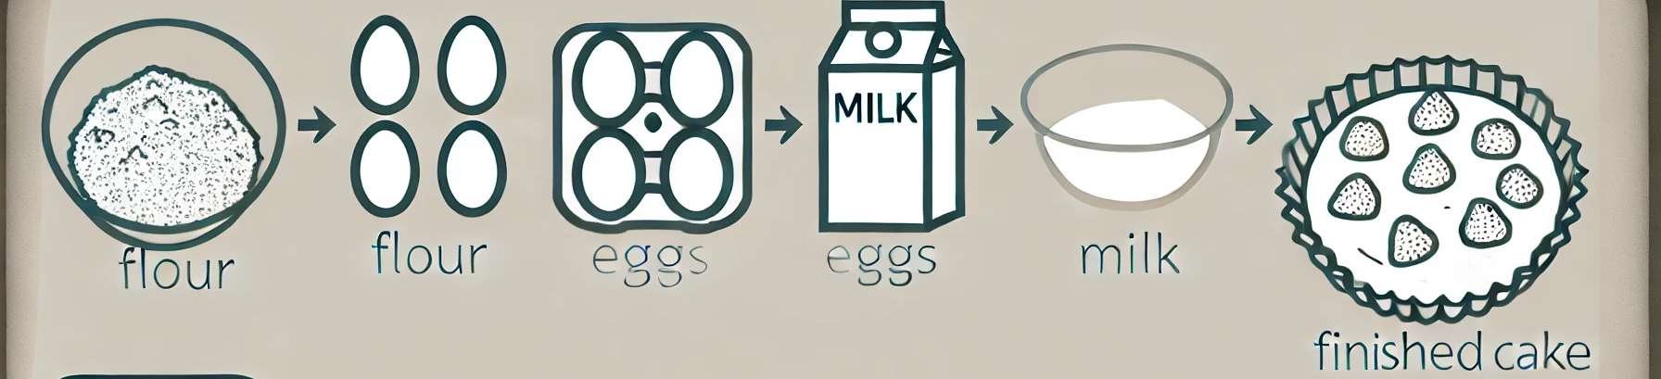
From Recipe to Results: Understanding Our Approach
Objective of this presentation:
To demonstrate the full value of our project beyond the results
Breaking down our process and components to show how the model works.
Eugenio Melo & Qingdong Zhu
Notes:
Rather than just presenting the results, or our “cake,” let’s go back to the kitchen and discuss the ingredients, the recipe, and how elements like flour, milk, and eggs come together to create that cake, and why that transformation happens.

Slide 5
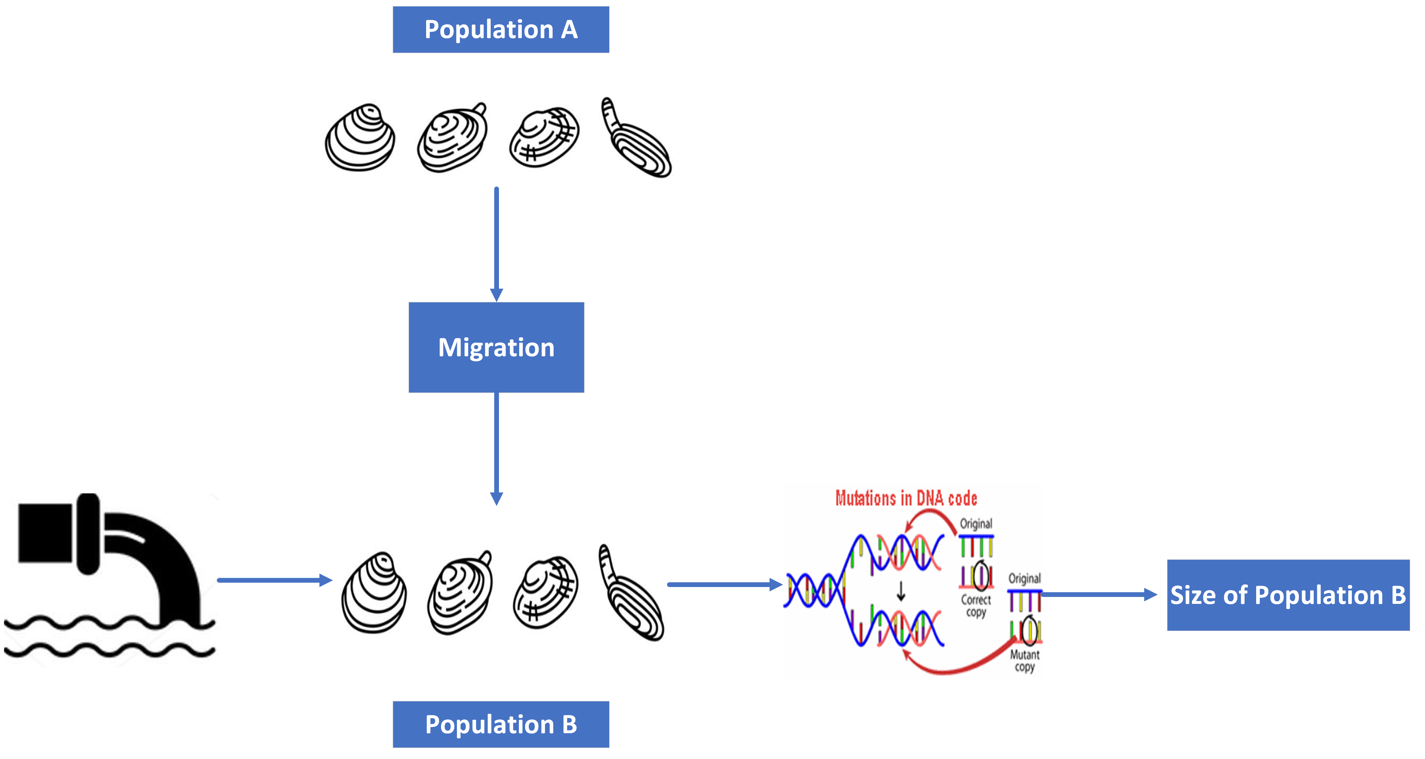
Our Biological Question
Can migration and mutation enable a population to survive and adapt in a polluted environment, despite environmental pressures?
How does migration influence population stability in a polluted ecosystem?
Can a beneficial mutation increase resilience in the population over time?
What are the limits of recovery through migration alone?
Eugenio Melo & Qingdong Zhu
Notes:
Our biological question is: Can migration and mutation enable a population to survive and adapt in a polluted environment despite environmental pressures?
This question helps us understand how migration might support stability by adding new individuals, while beneficial mutations could increase resilience. These insights can guide conservation efforts, like improving connectivity in polluted habitats to support species recovery

Slide 6
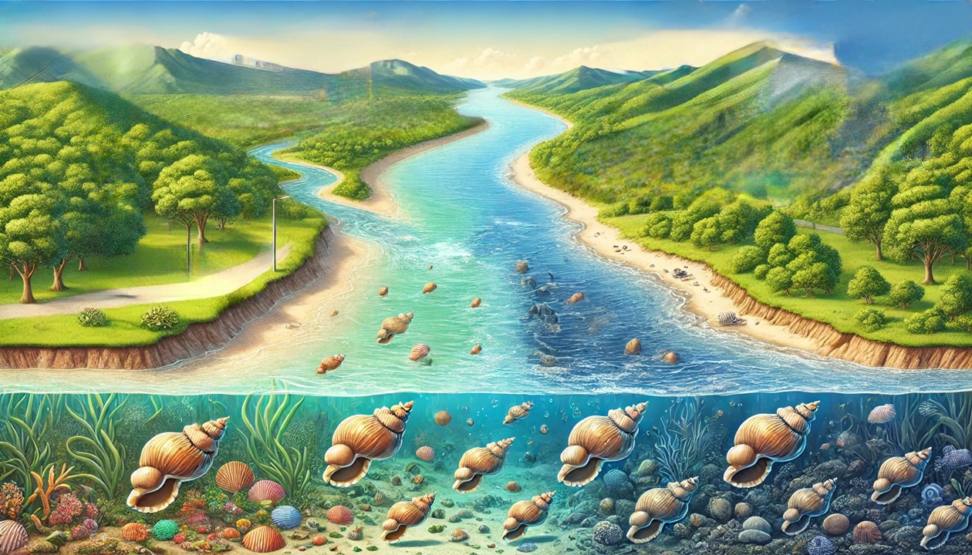
Understanding the Ecosystem Dynamics
Two mussel populations: One upstream, one downstream
Eugenio Melo & Qingdong Zhu
Notes:
Our project started with the idea that, in a dynamic ecosystem like a river, multiple factors act simultaneously. So, Imagine a river with two mussel populations in separate sections.

Slide 7
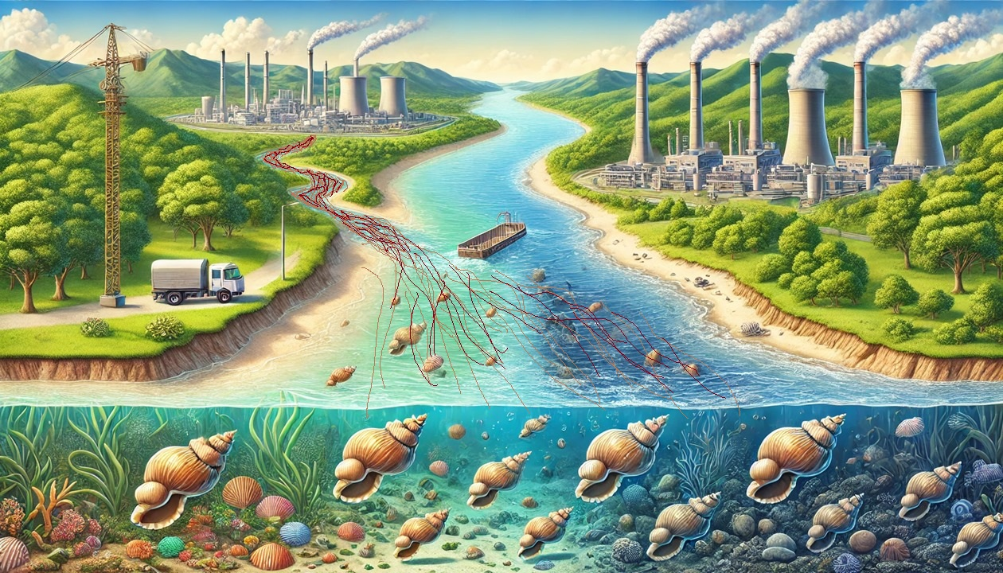
Understanding the Ecosystem Dynamics
Two mussel populations: One upstream, one downstream
Eugenio Melo & Qingdong Zhu
Notes:
At a certain point, an industry is established and begins discharging untreated effluent near the downstream population, causing it to decrease due to pollution. We wondered if migration from the upstream population could help rescue the downstream population in this polluted area. We also considered factors like competition within the polluted area and the emergence of a single beneficial mutation over time, following concepts discussed by Orr & Unckless. The idea here is that mutants might develop increased resistance to contaminants.

Slide 8
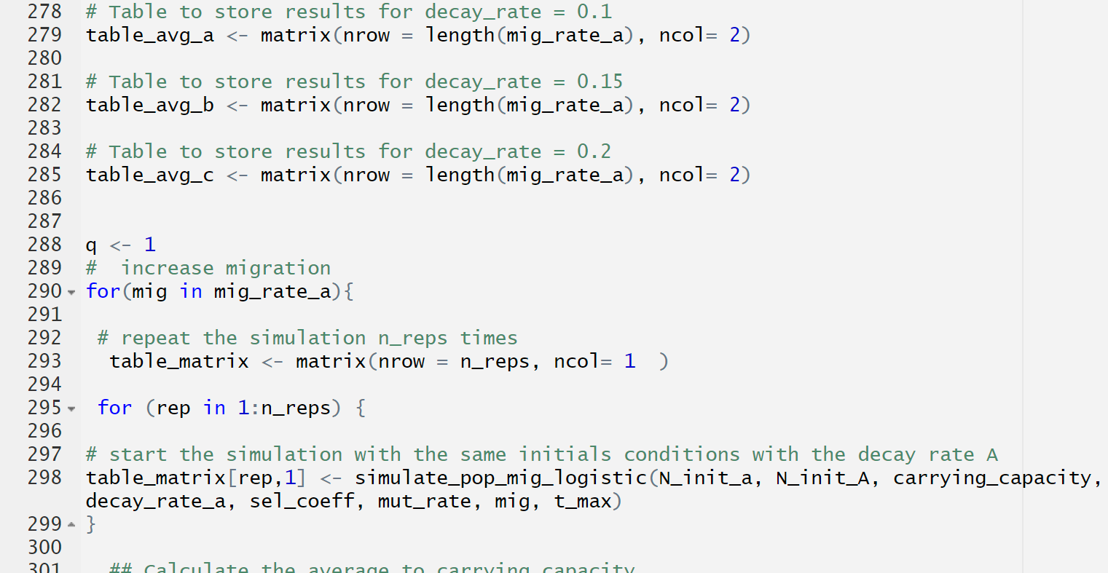
Modeling the Dynamics: From Insights to Outcomes
To model and analyze interactions in evolutionary ecology
Why are we observing these results?
Eugenio Melo & Qingdong Zhu
Notes:
With these insights, we began coding to model potential outcomes and aimed to understand how to explain this interaction theoretically within evolutionary ecology. As we started obtaining results, we examined why we were seeing these specific outcomes.

Slide 9
Model Parameters and Setup
Starting Population: 1,000 wild-type individuals
Starting Population: 0 mutant individual
Mutation Rate: 0.001
Carrying Capacity: 1,000
Decay Rate: ‘a’: 0.1; ‘b’: 0.15; ‘c’: 0.2
Selective Coefficient: 0.3
Migration Rate: from 1 to 200
T_max: 1000 generations
Number of repetitions: 1000
Biological question:
Can migration and mutation enable a population to survive and adapt in a polluted environment, despite environmental pressures?
Eugenio Melo & Qingdong Zhu
Notes:
In our model, we start with a population that begins with **1,000 wild-type** individuals.
In the first generation after pollution, a variant with a single beneficial mutation appears in discrete time. This mutation allows the variant to survive and expand in the polluted environment, although it initially has a zero frequency in the population. To rescue the population, this mutant needs to outcompete the wild type. If it isn’t present at time zero, it must emerge through mutation and then spread throughout the population before “extinction” occurs. In this simulation, we set the mutation rate at 0.001.
We also set the carrying capacity at 1,000, the three decay rate 0.1, 0.15 and 0.2, and the selective advantage of the mutant (or selection coefficient) at 0.3. Migration is ongoing in the model, initially set at a rate of 1, never in zero, and we finished in 200. At the beginning, we aim to observe the numbers of wild-type and mutant individuals over time.

Slide 10
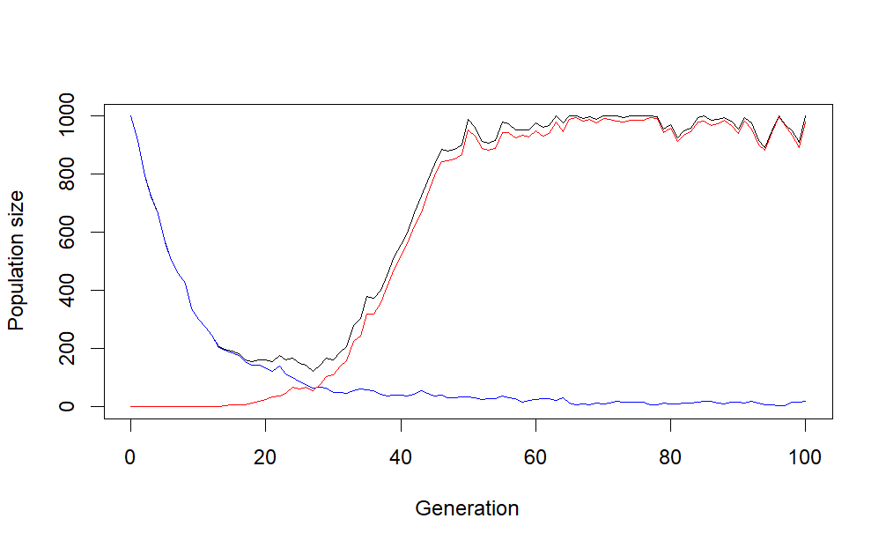
Simulating Population Reproduction
Wildtype
Mutant
Total population size
Eugenio Melo & Qingdong Zhu
Notes:
The first step simulates one generation of the population. In each generation, both wild-type and mutant individuals reproduce. We modelled this reproduction using a Poisson random variable—a statistical method that predicts the expected number of offspring. For wild-type individuals, the expected number is based on the decay rate, while for mutants, it considers both the decay rate and the selective advantage of the mutation. This Poisson model helps simulate population changes by accounting for random fluctuations in reproduction, creating a more realistic representation of population dynamics.
We can see the decrease of the wild-type population alongside a substantial increase in the mutant population. Here, the mutants effectively 'rescue' the population, but how we are simulating here, there is no opportunity extinction because migration from another population is still ongoing.
Now, let's discuss the main areas we could explore further. While we can track population dynamics from one generation to the next, we wanted to go beyond this. So, we decided to follow the population from time zero until it either stabilizes through rescue or reaches close to extinction

Slide 11
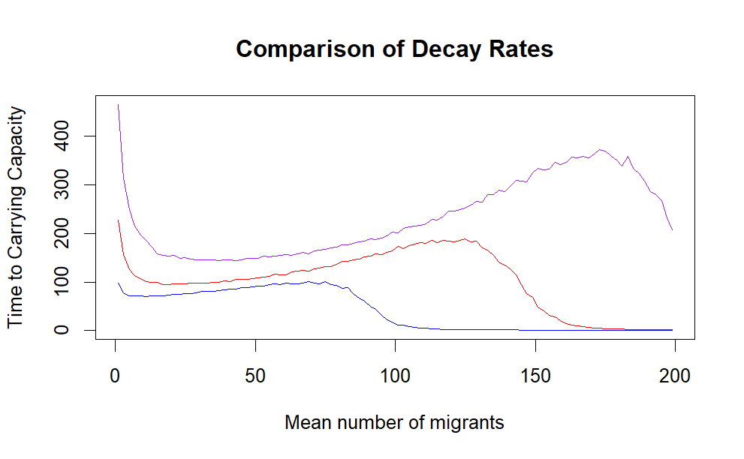


Mutation rate = 0.001
Decay rate = 0.1
Decay rate = 0.15
Decay rate = 0.2
Generations to Carrying Capacity
Eugenio Melo & Qingdong Zhu

Slide 12
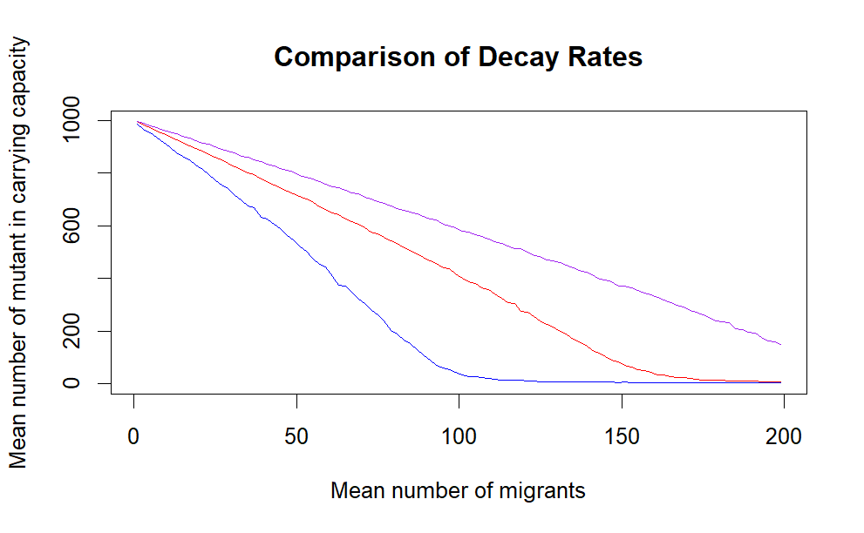
Who dominate this process?
Decay rate = 0.1
Decay rate = 0.15
Decay rate = 0.2
Eugenio Melo & Qingdong Zhu

Slide 13
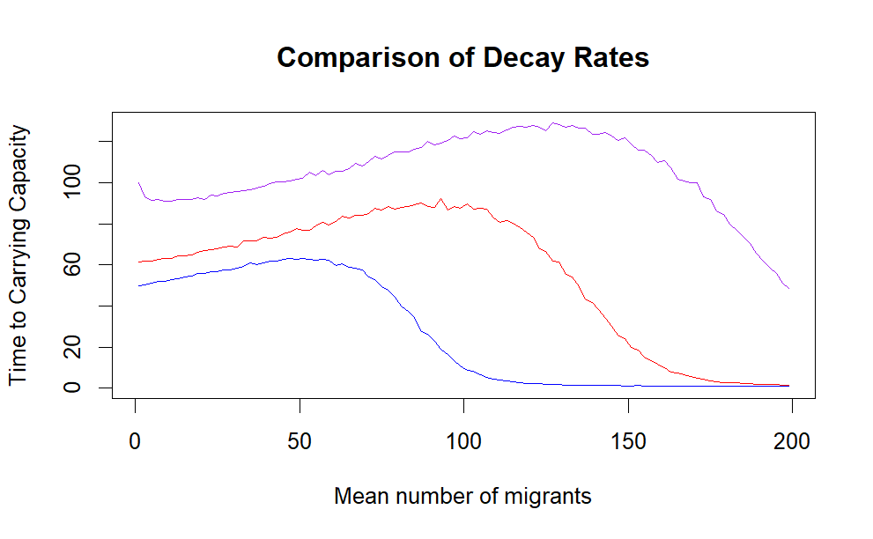
Mutation rate = 0.005
Decay rate = 0.1
Decay rate = 0.15
Decay rate = 0.2
Generations to Carrying Capacity
Eugenio Melo & Qingdong Zhu

Slide 14
Key Takeaways and Future Directions
Migration: Supports stability by adding new individual
Mutation: Increases resilience in polluted areas
Combined Effect: Helps “rescue” populations under stress
Conservation Implications
Enhance connectivity for species survival
Pollution reduction remains essential.
Future Research
Explore other environmental factors
Apply this model to other ecosystems
Eugenio Melo & Qingdong Zhu
Notes:
To conclude, our study explored how migration and mutation could support population stability in a polluted environment. We found that migration plays a crucial role in stabilizing the population by adding new individuals, while beneficial mutations provide resilience, allowing populations to adapt over time. However, we also saw that high environmental stress, represented by decay rates, can significantly delay recovery, highlighting the limits of migration alone in extreme conditions.
In terms of conservation, these insights suggest that enhancing connectivity between habitats can help species survive in polluted areas. However, reducing pollution remains essential, as migration alone cannot fully counterbalance severe environmental impacts.
Looking forward, future research could explore other environmental factors impacting population dynamics and test this model across other ecosystems to improve its predictive power.
Thank you for your attention. I’d be happy to answer any questions

Slide 15
Questions?
Eugenio Melo & Qingdong Zhu
Notes:
In our model, we start with a population that begins with **1,000 wild-type** individuals.
In the first generation after pollution, a variant with a single beneficial mutation appears in discrete time. This mutation allows the variant to survive and expand in the polluted environment, although it initially has a zero frequency in the population. To rescue the population, this mutant needs to outcompete the wild type. If it isn’t present at time zero, it must emerge through mutation and then spread throughout the population before “extinction” occurs. In this simulation, we set the mutation rate at 0.001.
We also set the carrying capacity at 1,000, the three decay rate 0.1, 0.15 and 0.2, and the selective advantage of the mutant (or selection coefficient) at 0.3. Migration is ongoing in the model, initially set at a rate of 1, never in zero, and we finished in 200. At the beginning, we aim to observe the numbers of wild-type and mutant individuals over time.

